Slide 1
Generative Adversarial Networks

Slide 2
Motivation
Use deep learning to generate data similar to targets
Ideally can’t distinguish generated data from real data
Training data augmentation
Primarily focused on images
Many other use cases developed

Slide 3

Perfecting Counterfeit

Slide 4
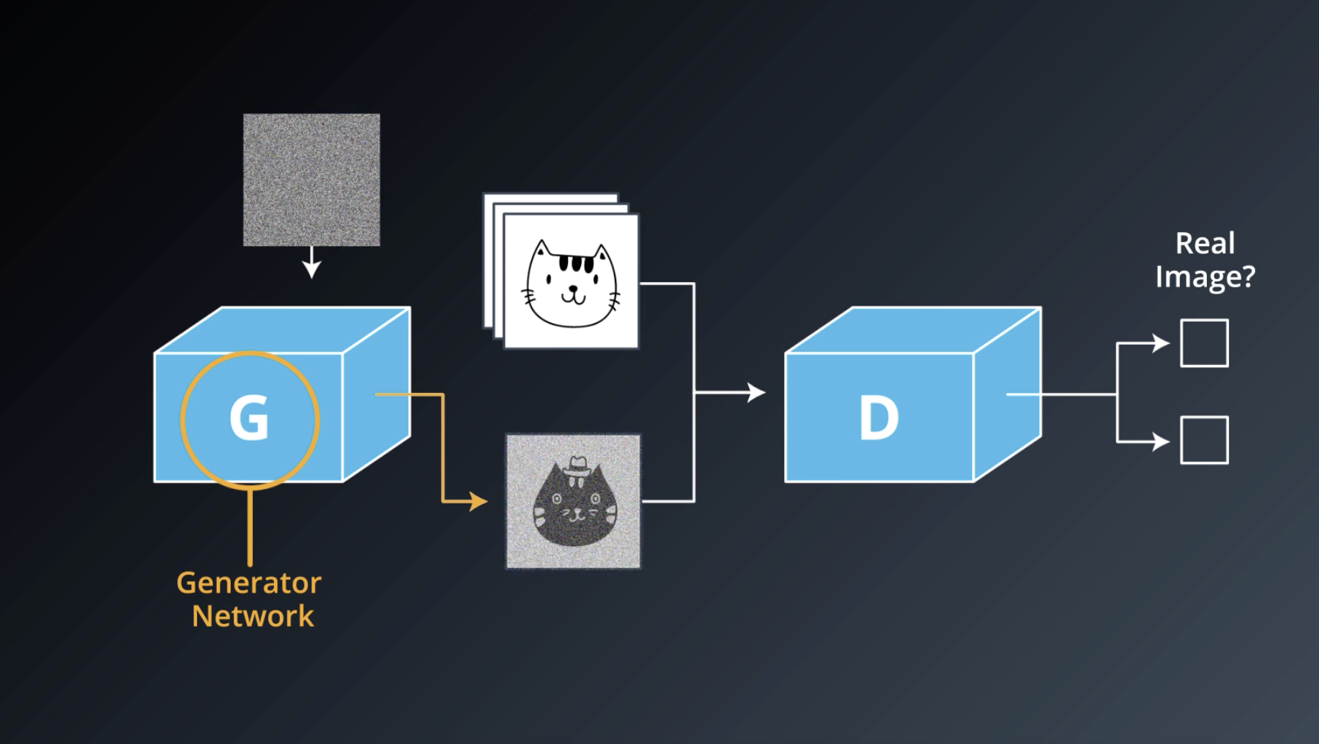
GAN Architecture
Generator is blind

Slide 5

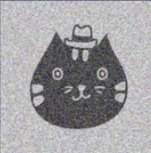
Generator Training
Real (1)
Generator
Discriminator
Fake (0)
Input to generator is a tensor of random values (e.g., an array of values between -1 and 1)
Output of generator is a tensor holding an image (e.g., an array of 784 values for an MNIST image)
No loss function for the generator
Last layer of discriminator is a sigmoid function
Label for discriminator is 0 (it should identify input as fake image)
Loss = difference between label and sigmoid output (cross entropy loss)
Compute gradients to back-prop
Update generator parameters only

Slide 6
Pseudo Code
G = generator, D = discriminator
optimizer (g.parameters)
input = random(seed)
fake_image = G(input)
output = D(fake_image)
loss = cross_entropy(output, 0)
loss.backward()

Slide 7
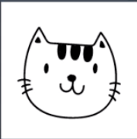
Discriminator Training Part 1 (Real Images)
Real (1)
Discriminator
Fake (0)
Input to discriminator is a real image (e.g., an array of 784 values for an MNIST image)
Last layer of discriminator is a sigmoid function
Label for discriminator is 1 (it should identify input as real image)
Loss_1 = difference between label and sigmoid output (cross entropy loss)

Slide 8
Discriminator Training Part 2 (Fake Images)
Real (1)
Generator
Discriminator
Fake (0)
Input to generator is a tensor of random values (e.g., an array of values between -1 and 1)
Output of generator is a tensor holding an image (e.g., an array of 784 values for an MNIST image)
No loss function for the generator
Last layer of discriminator is a sigmoid function
Label for discriminator is 1 (it should identify input as fake image)
Loss_2 = difference between label and sigmoid output (cross entropy loss)
Update discriminator parameters only
Use generator as an inference engine

Slide 9
Pseudo Code
G = generator, D = discriminator
input = random(seed)
fake_image = G(input)
output = D(fake_image)
loss_2 = cross_entropy(output, 0)
optimizer (d.parameters)
loss = loss_1 + loss_2
loss.backward()
input = real image
output = D(input)
loss_1 = cross_entropy(output, 1)

Slide 10
GAN Techniques
Leaky ReLU for activation
tanh for fake image values
Batch normalization
Label smoothing (e.g., use 0.9 instead of 1 for ground truth)
Normalize inputs to (-1, 1)
No pooling layers if CNN is used

Slide 11
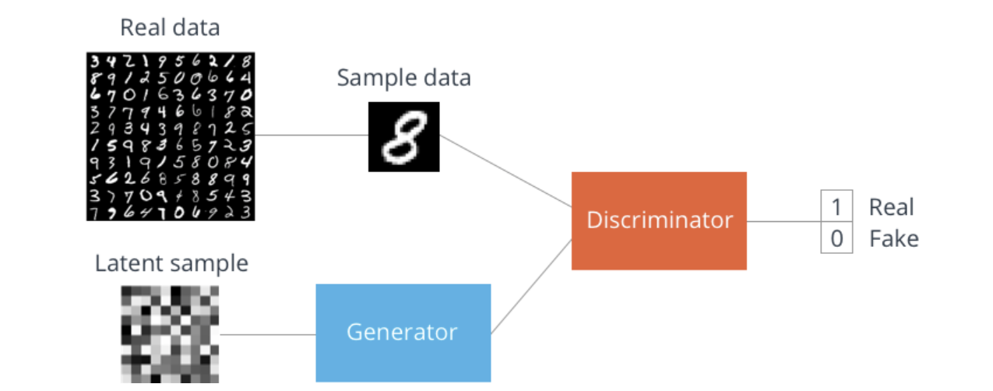
MNIST Data Generation
feed-forward networks only

Slide 12
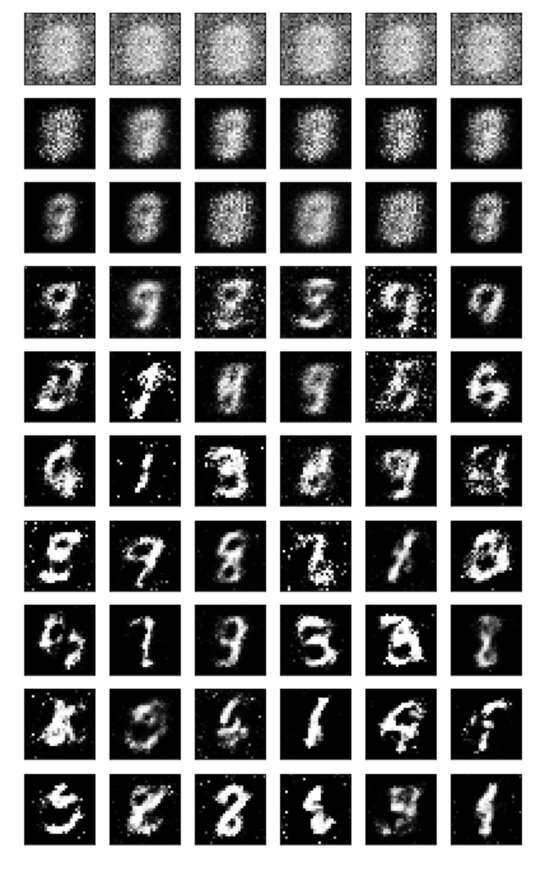
MNIST Data Generation

Slide 13
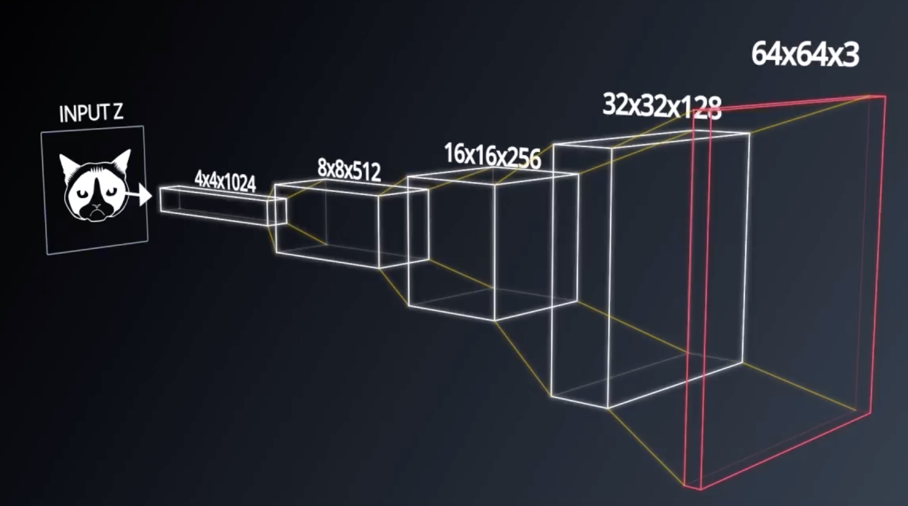
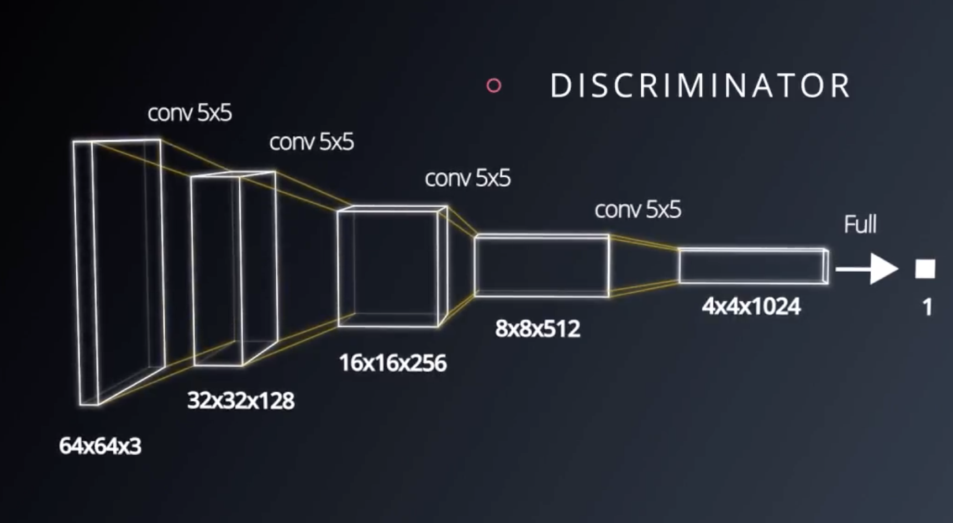
DCGAN Architecture

Slide 14
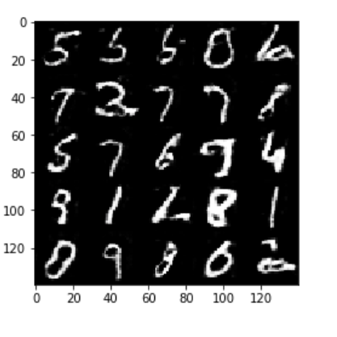
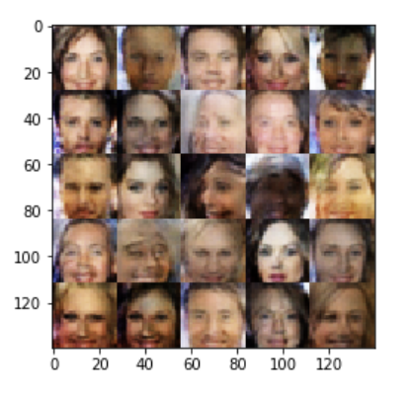
DCGAN Output

Slide 15
Use Cases
StackGAN
Generate high quality images from text descriptions
SRGAN
Increase resolution of an image
CycleGAN
Image-to-image translation
https://www.youtube.com/watch?v=Fea4kZq0oFQ
DiscoGAN
Discover cross-domain relations

